Slide 1
Lecture 27:
Naming aromatic compounds
Reactions of aromatic compounds

Slide 2
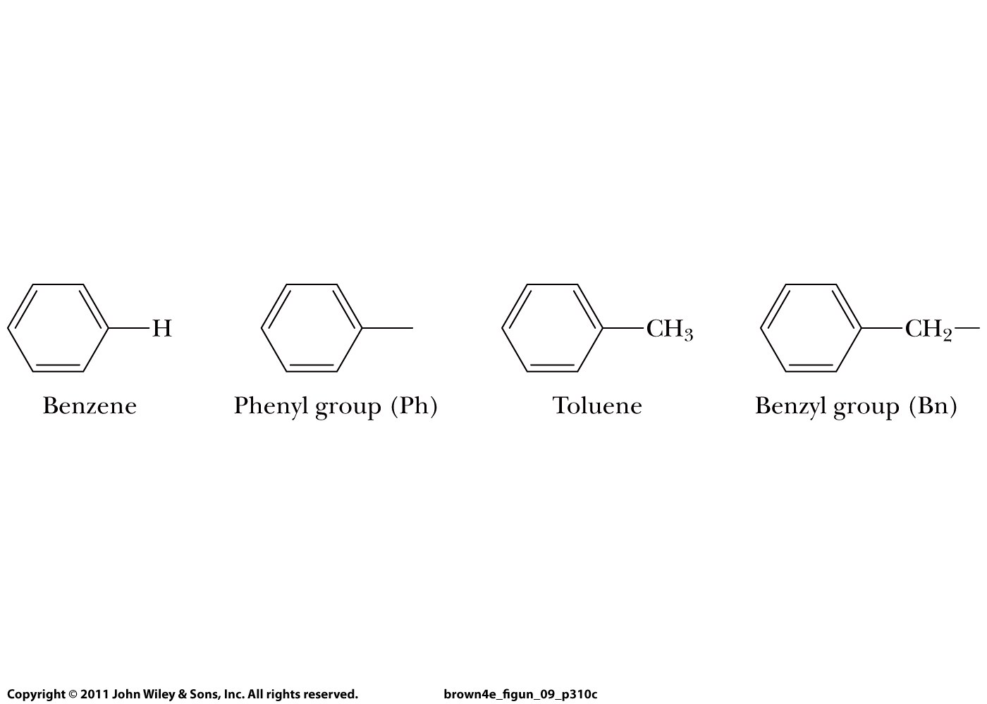

Slide 3
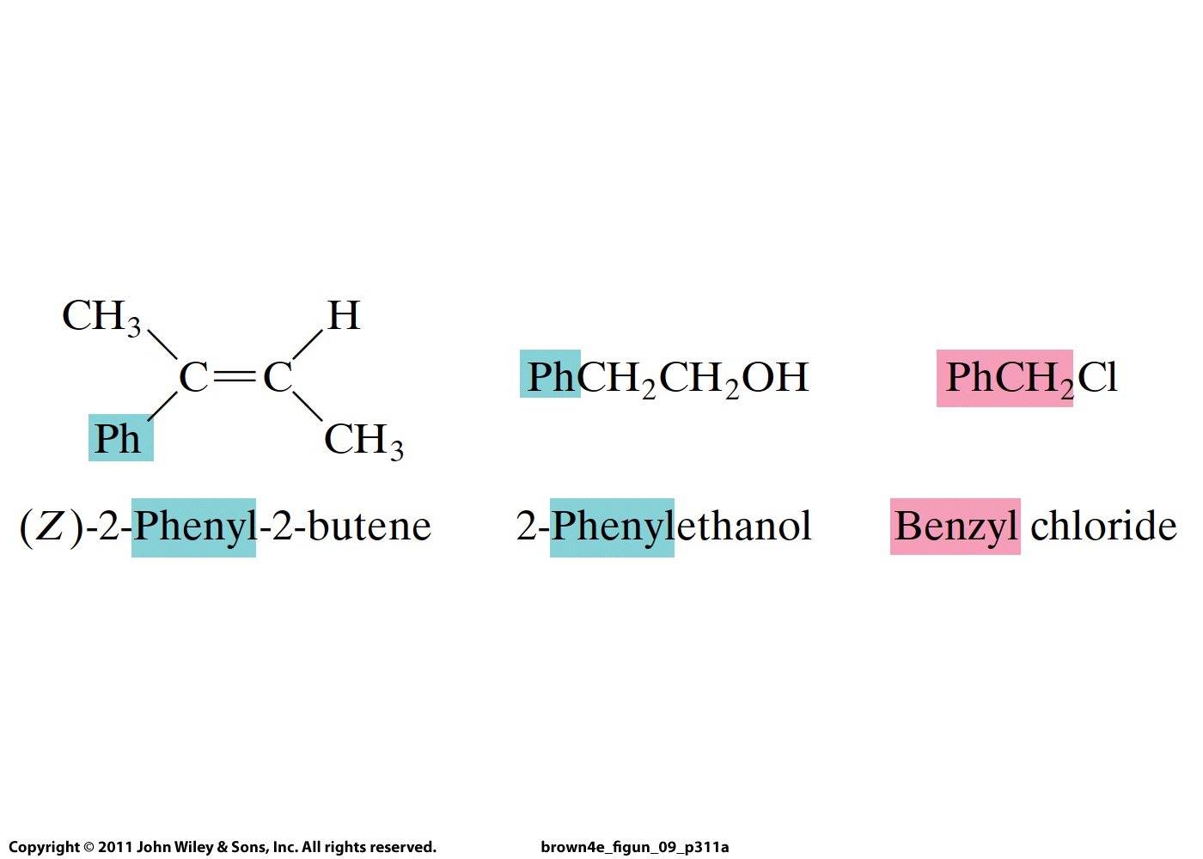
Buddy Question # 95
Name this molecule:

Slide 4
Buddy Question # 95
Name this molecule:
(Z)-2-phenyl-2-butene

Slide 5
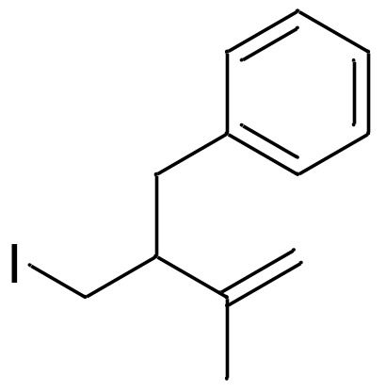
Buddy Question # 96
Name this compound

Slide 6
Buddy Question # 96
Name this compound
3-benzyl-4-iodo-2-methyl-1-butene

Slide 7
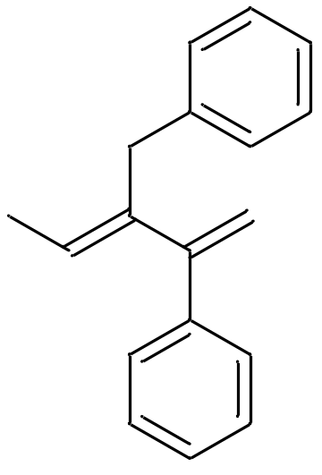
Buddy Question # 97
Name this compound

Slide 8
Buddy Question # 97
Name this compound
(E)-3-benzyl-2-phenyl-1,3-pentadiene

Slide 9
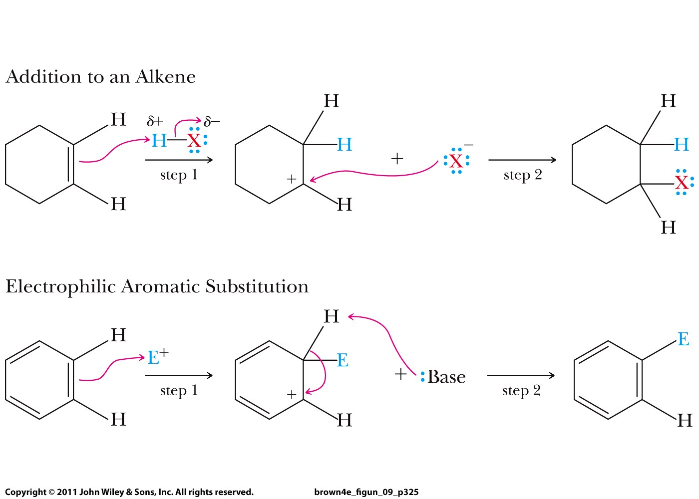

Slide 10
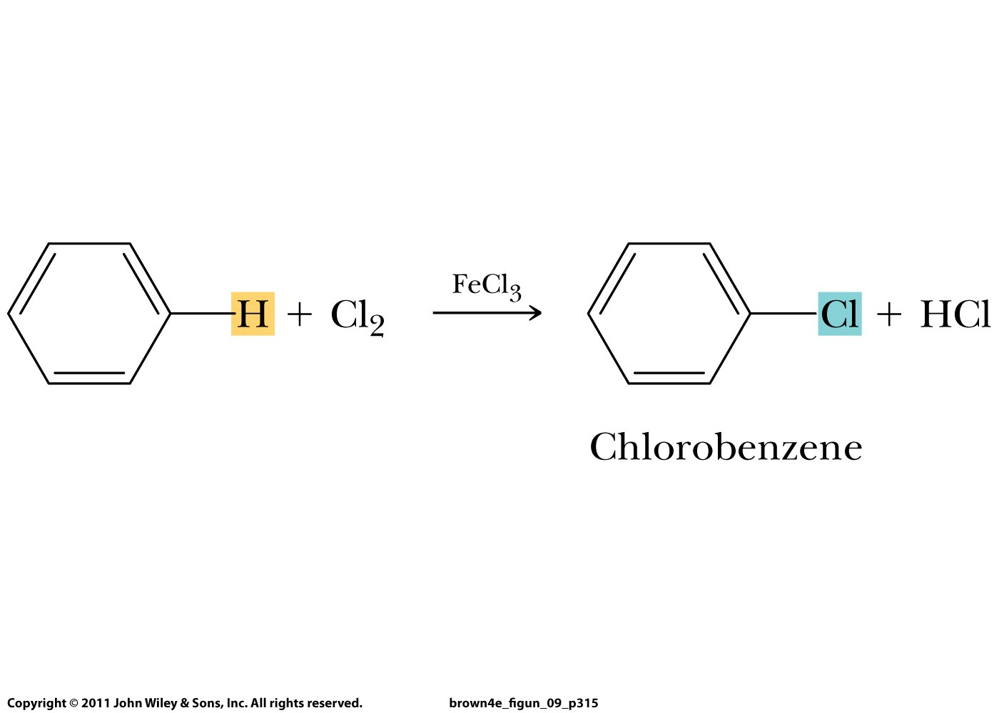
Electrophilic aromatic substitution:
catalyst
EX
E

Slide 11
Electrophilic aromatic substitution:
catalyst
EX
E
E⁺ = electrophile

Slide 12
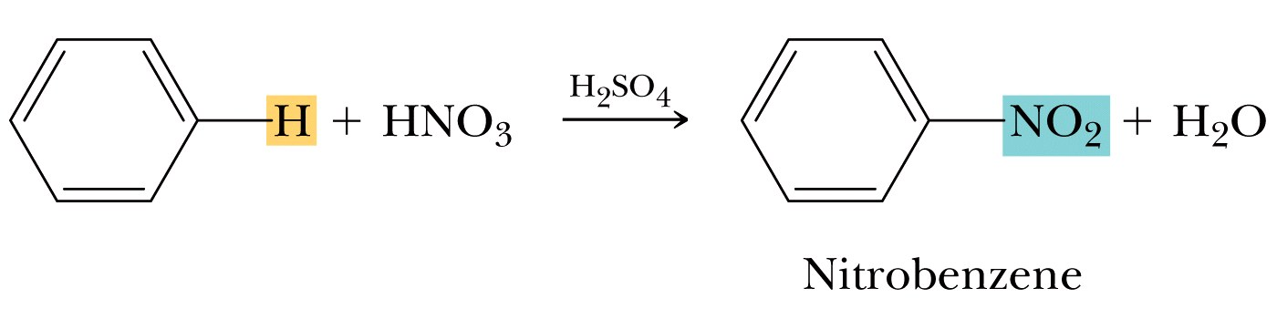
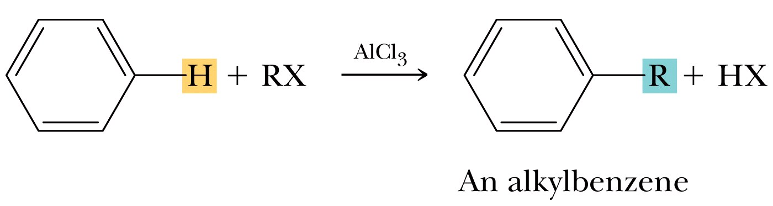
X = Cl, Br, I

Slide 13
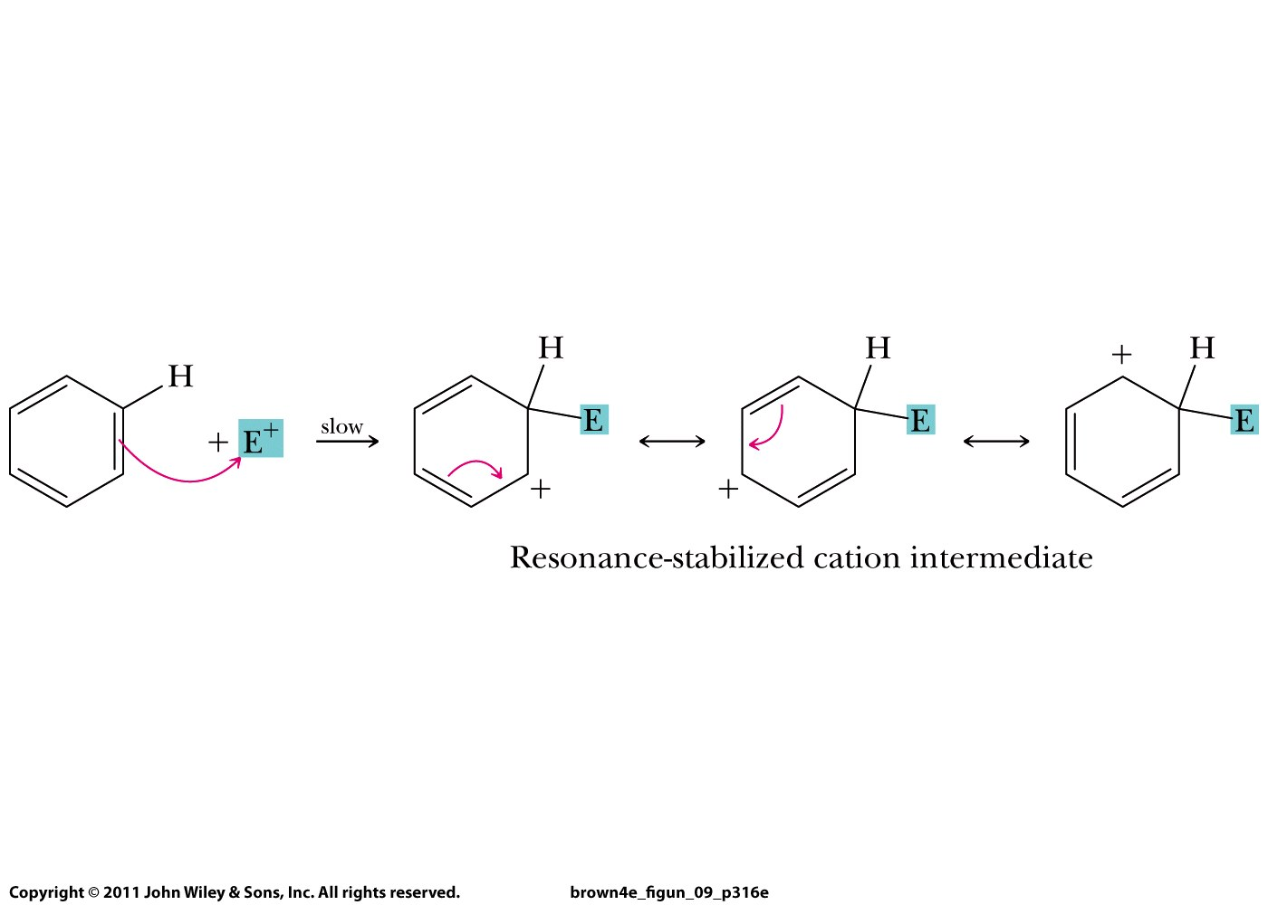
Mechanism:

Slide 14
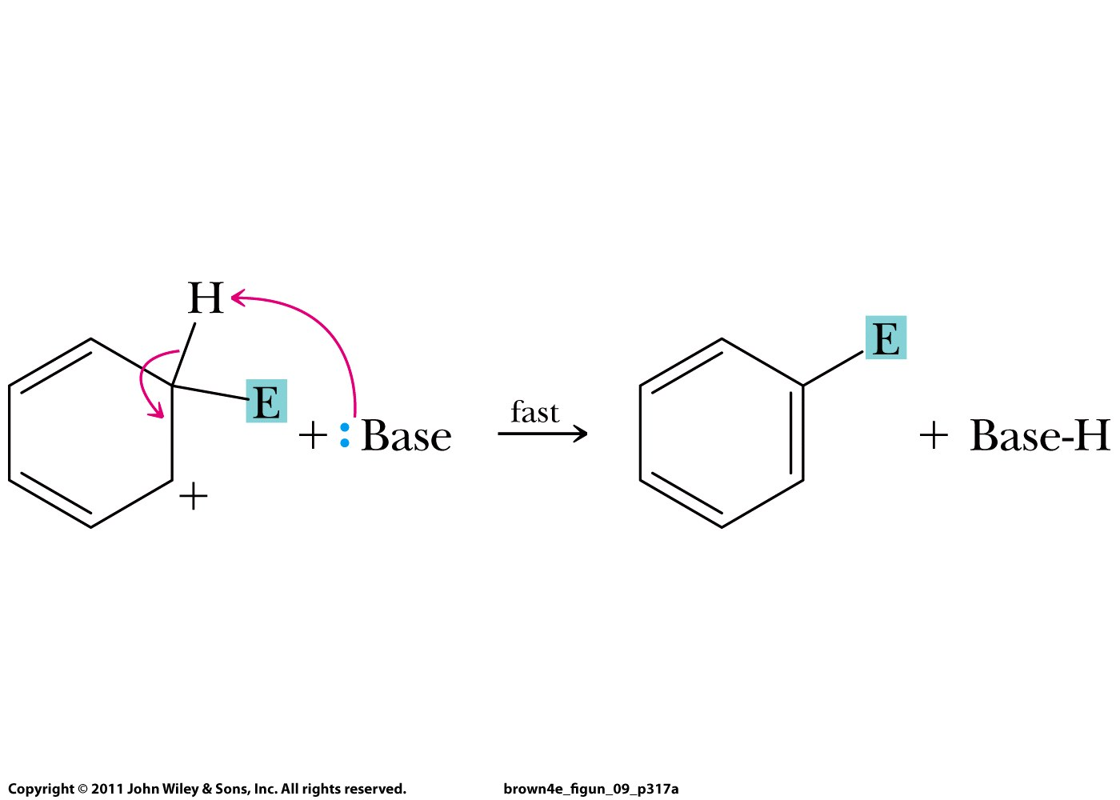

Slide 15
Halogenation

Slide 16
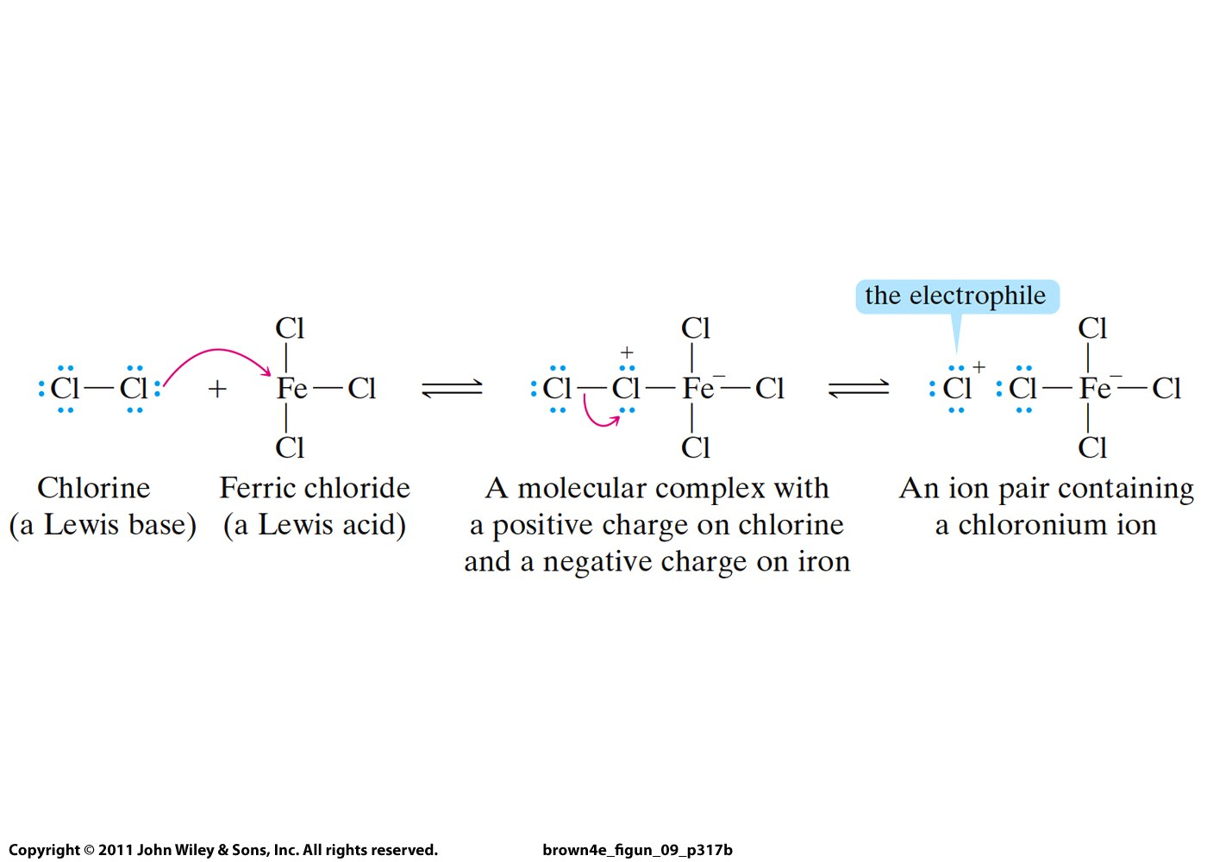

Slide 17
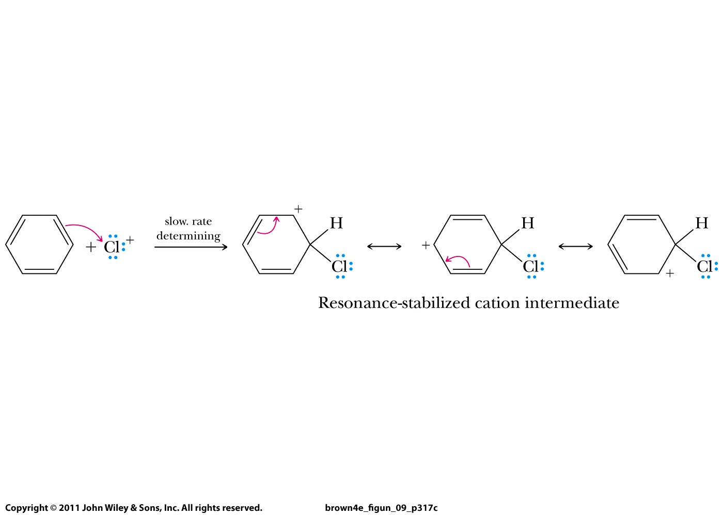

Slide 18
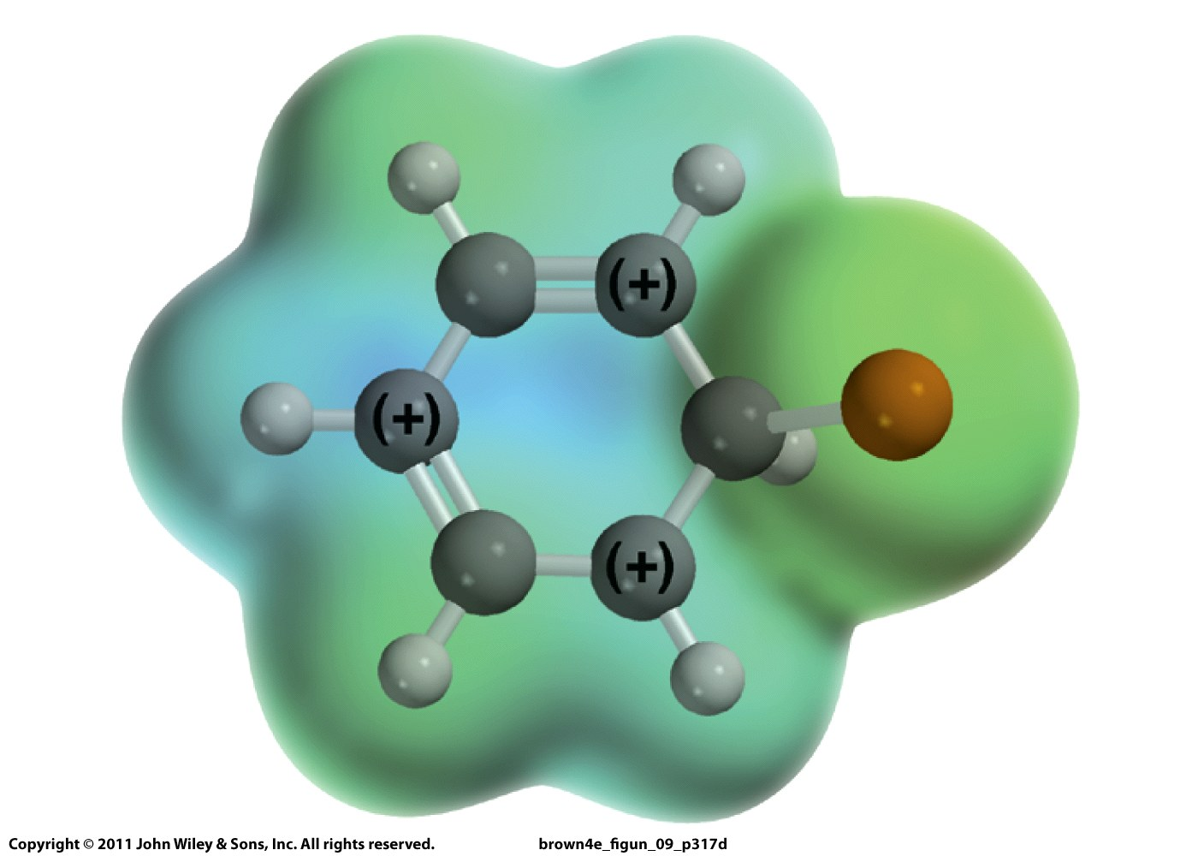

Slide 19
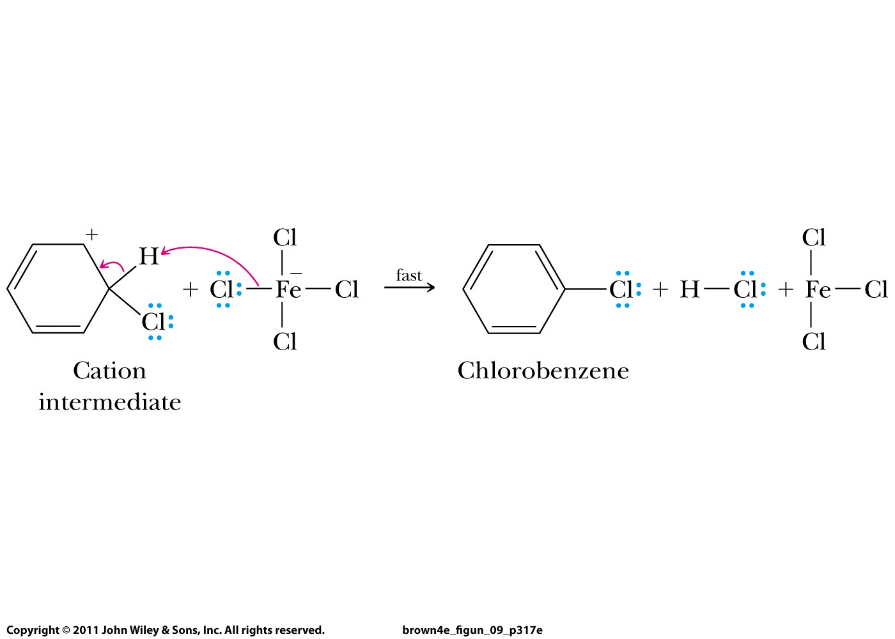

Slide 20
X = Cl, Br, I

Slide 21
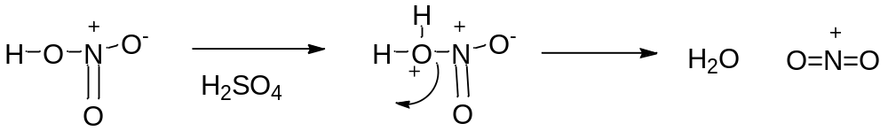
Nitration

Slide 22
X = Cl, Br, I

Slide 23
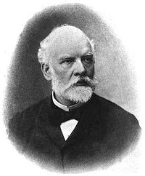
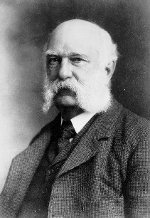
1877 Charles Friedel (French) and James Crafts (American)
Charles
James

Slide 24
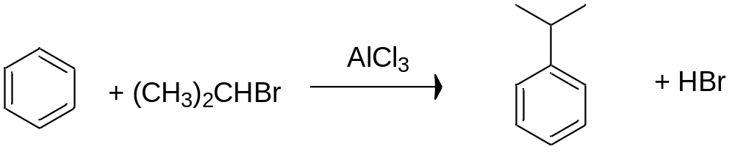
Buddy Question # 98
Show the products for this Friedel-Crafts alkylation

Slide 25
Buddy Question # 98
Show the products for this Friedel-Crafts alkylation

Slide 26
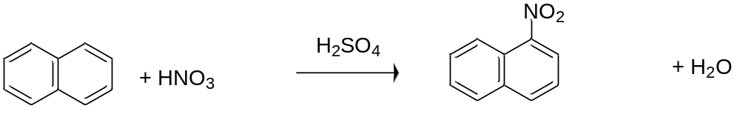
Buddy Question # 99
Show the products for this reaction

Slide 27
Buddy Question # 99
Show the products for this reaction

